Slide 1
Religion as Alienation
KARL MARX
RELS 1210 – CLASS 14
MANDY MACARTHUR

Slide 2
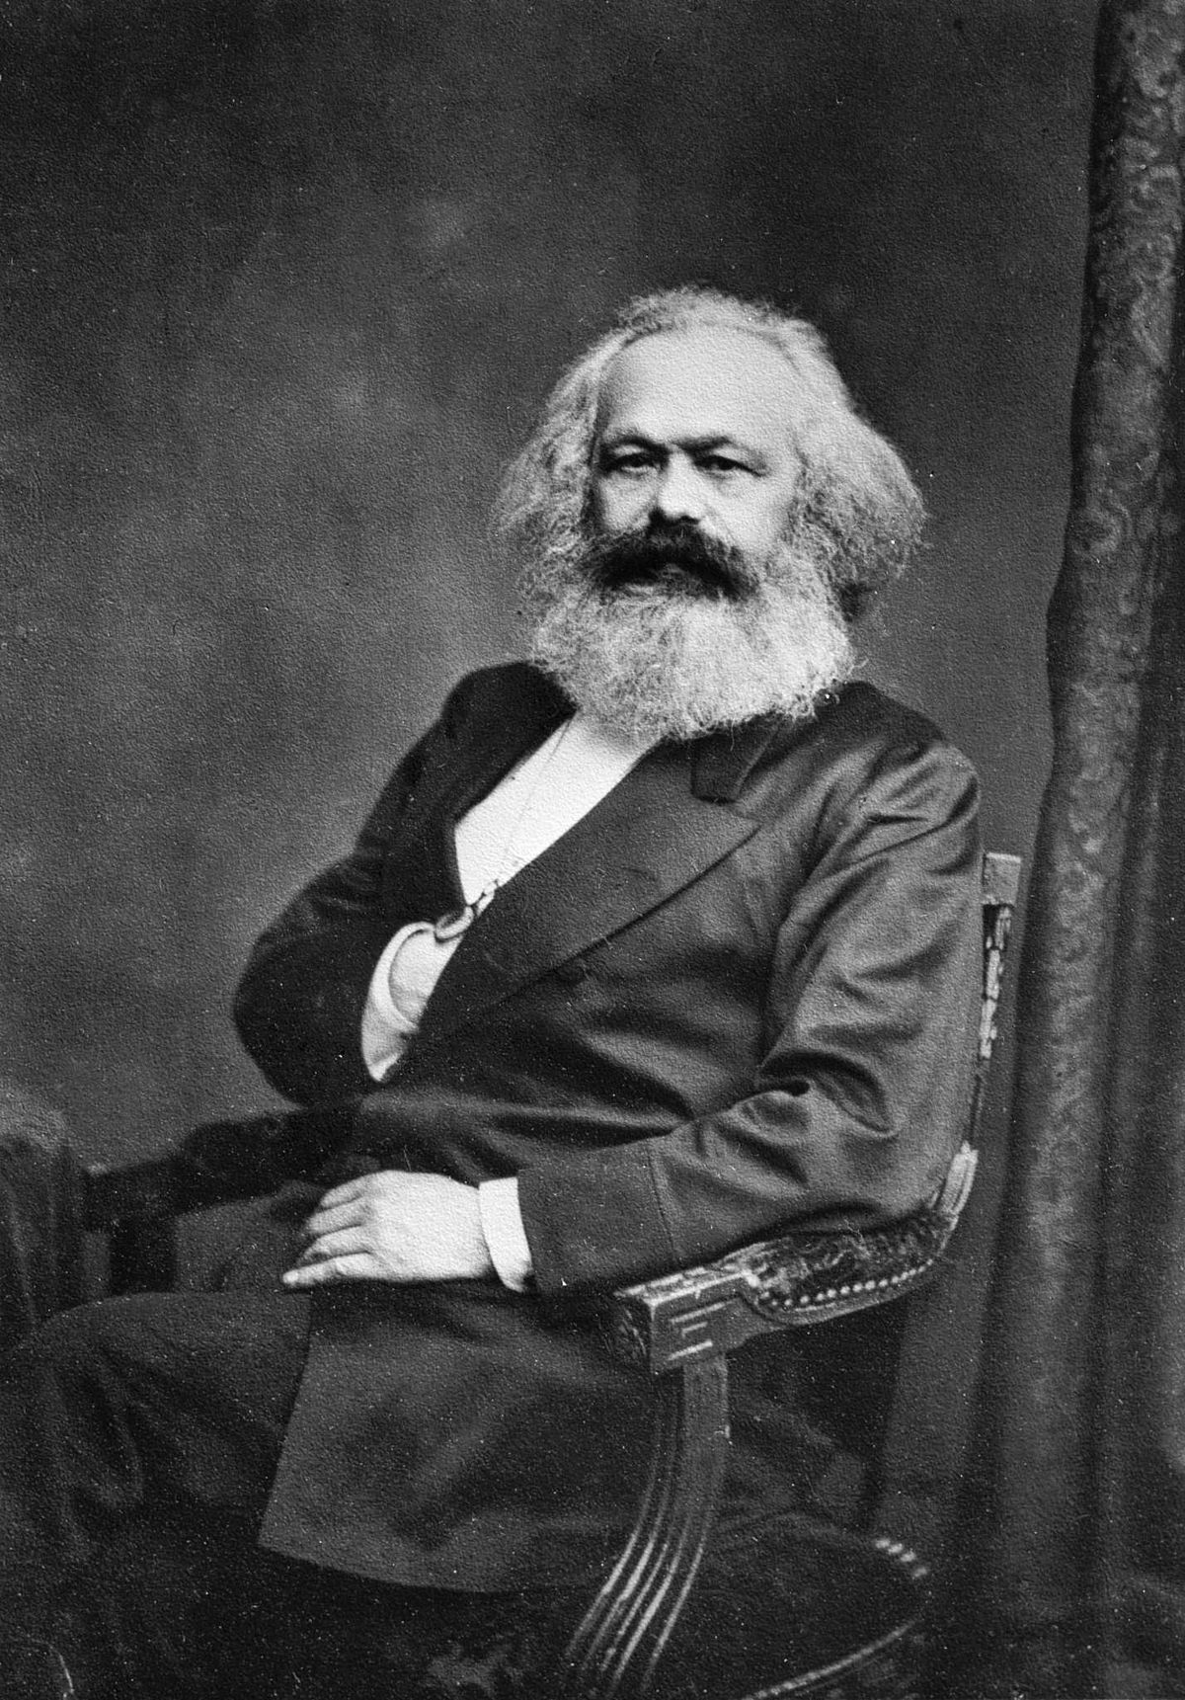
Karl Marx
1818 – 1883
German philosopher
Known as the “guiding spirit” of Communism
He worked earlier than the other theorists we’ve looked at so far, BUT his impact was felt much later in history
“Marx own century could ignore him, but its successors cannot” (114)
Presents more of an all-encompassing system of thought, rather than a solely religious perspective, that resembles a religion itself
A ruling philosophy of governments in many parts of the world

Slide 3
Communism
“Marx’s writings are as sacred to some communists as is the Bible to the most sincere and devout Christians.” (114)
COMMUNISM – a communal society in which all types of property and income are shared, and each person is paid directly according to their labor, abilities, and needs
“communism offers a system of doctrines with authorized interpretation.” (114)
It has sacred places, people, and ceremonies that can be deemed rituals
Communism as itself can be considered a religion → offering a total vision of human life, a philosophical explanation of human’s purpose in the world, a detailed explanation of human history, and a fore-telling of the future
Marx did not, however, address the subject of religion like our other theorists
This means we have to deal with his theories a little differently in order to construct a clear stance on religion

Slide 4
Life
1818 – born into a large Jewish family in Trier, Germany → a city at that time that was powerful and ruled by Christian noble families
This caused his family to convert from Judaism to Christianity
He was stubborn and outspoken from a young age, and he would often get in drunken fights with people even as a young scholar
However, he became more serious about his studies when he started at the University of Berlin
This university, plus others in Germany at the time, were highly influenced by the philosophy of Georg Wilhelm Friedrich von Hegel

Slide 5
Absolute Idealism
Hegel’s main conceptual theory was based in philosophy that mental things (thoughts and ideas) were primary to the world, while physical things (objects made up of matter, including human bodies) were secondary.
The secondary things were only a physical representation of consciousness or the mind
This consciousness (these ideas and thoughts) was also known, according to Hegel, as the universal spirit, or Absolute Idea
Absolute Idealism – a monistic philosophy that claims our ideas/ thoughts are actually what makes up reality
The only thing truly knowable is our consciousness and we cannot be sure that anything material outside of our thoughts actually exist, or at least the way we perceive it…
The only real thins are mental entities, not physical entities
This idealist (idealism) viewpoint does not require a God, supernatural beings, or any type of existence after death

Slide 6
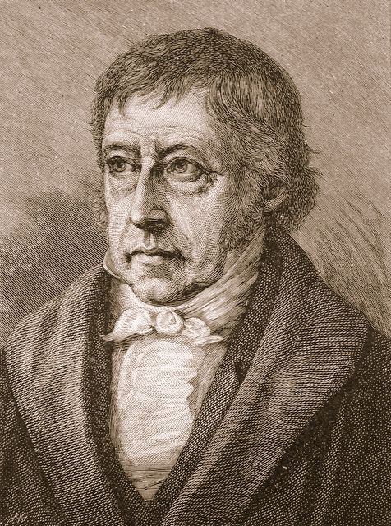
Hegel argued that everyone’s individual mind is actually part of an Absolute Mind (collective and interconnected), whether we realize it or not
This impacts how we think as humans and binds us together
WHAT DOES THIS REMIND US OF?
He also argued that if we would begin to understand this greater consciousness, we wouldn’t be so concerned with individualism
All reality is the expression of thoughts

Slide 7
So, thinkers at the time in Germany had to interact with this philosophy in some way in order to be taken seriously
Marx aligned with the “Young Hegelians” or the Hegelians of the Left Wing
They argued that yes, Hegel was right to speak about the issue of mind and matter, BUT he got it backwards!
They argued that matter (physical entities) were primary and knowable, and the mind (idealistic entities) were secondary and just a reflection of the material world
Marx was a MATERIALIST
Hegel was an IDEALIST

Slide 8
Marx held an overarching materialistic view of the world and destiny
This was the foundation of all his later theories and arguments
He claimed the only truly real things about the world can be found in material forces, not in mental concepts
These material forces, according to Marx, that drove the world and human civilization can be summarized as the following:
1. economic realities determine human behaviour
2. all history is (and is due to) a class struggle → between the rich (those who owned things) and the poor (those who have to work to survive)
2 classes:
RICH = bourgeoisie → the class the owns and controls the majority of society’s wealth and means of production
POOR = proletariat → working class that is forced to sell their labor

Slide 9
Due to these bold and contradictory claims, he was unable to find success at the universities, so he decided to go off to write and publish on his own, writing political and philosophical essays
His key ideas on history, society, politics, and law the economy, as well as morals, philosophy, and religion were all highlighted in these publications
These essays were self-described as “the reckless criticism of all that exists”
WHY WOULD IT BE CONSIDERED RECKLESS?
Met Friedrich Engels, who was also a materialist, and together they published the Communist Manifesto (1848)
“Together they promoted their message of materialism, class struggle, communism, and revolution.” (117)
Marx was arrested in Belgium in 1848 and sent back in Germany, but he also began to revolt there and was arrested again
Luckily, he was acquitted of the charges and then went to London for the remainder of his life
Published Capital in 1867 – supported the materialist view and promoted a communist revolution
Died in London in 1883, mostly unnoticed

Slide 10
MARXISM – theories on society, economics, and politics
Capitalism
Human societies develop due to class struggle
There is a conflict between the ruling class (bourgeoisie) and the working class (proletariat)
He used his theory of materialism to predict that capitalism would eventually fail through self-destruction and a new system would replace it
SOCIALISM (communism)
A classless society
He argued that the working class should revolt against capitalism to incite social and economic emancipation (a new form of freedom)

Slide 11
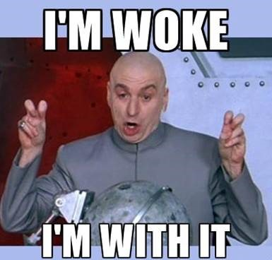
This new “freedom” he argued…
Offered a critique of religion and religious philosophies
Humans no longer had to be under the grip of false belief or religion
Humans came to realize, through intellect and reason, that they have two distinct selves
Actual and potential
The clashing (or ambivalence) of these selves creates a sense of alienation or disconnect of the self from the other (the mind and the matter)
Religion worked to keep these true selves hidden and “happy”
But we had to WAKE UP! STAY WOKE!

Slide 12
“RELIGION IS THE SIGN OF THE OPPRESSED CREATURE, THE HEART OF THE HEARTLESS WORLD, AND THE SOUL OF SOULLESS CONDITIONS. IT IS THE OPIUM OF THE PEOPLE. THE ABOLITION OF RELIGION AS THE ILLUSORY HAPPINESS OF THE PEOPLE IS REQUIRED FOR THEIR REAL HAPPINESS. THE DEMAND TO GIVE UP THE ILLUSION ABOUT ITS CONDITION IS THE DEMAND TO GIVE UP A CONDITION WHICH NEEDS ILLUSIONS.” (Marx 42)

